Slide 1
TRANSPARENT APPLICATION DEPLOYMENT IN A SECURE, ACCELERATED AND COGNITIVE CLOUD CONTINUUM
WP4 - Cloud and Edge Acceleration
Task 4.2: Performance Maximization under Maximum Affordable Error in Cloud and Edge
High Performance Computing Center, Stuttgart-HLRS
Javad Fadaie Ghotbi
8th plenary meeting
<number>
Notes:
<number>

Slide 2
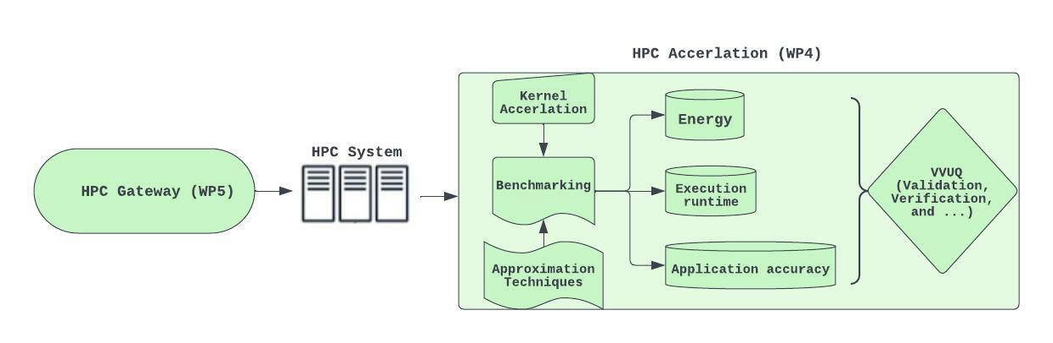
T4.2-Acceleration of Kernels in the HPC System
Integration of kernels in the HPC System
<number>

Slide 3
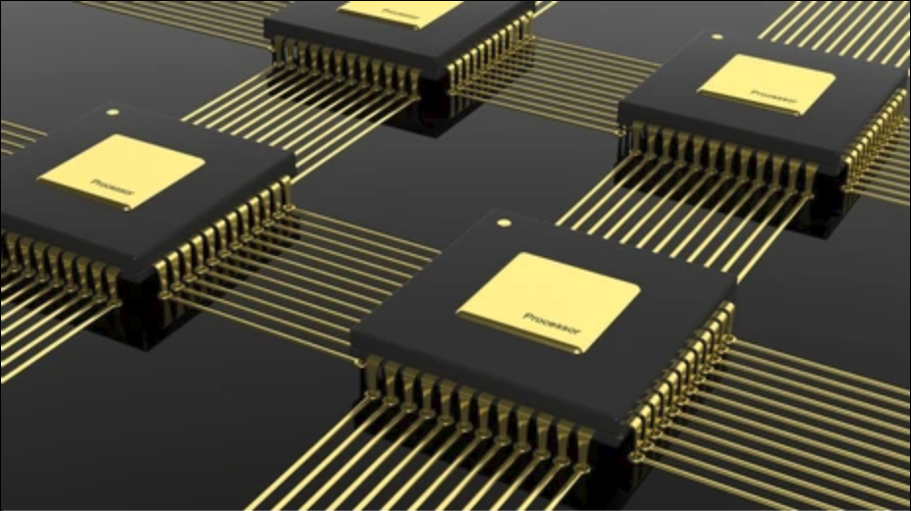
T4.2-Acceleration of Kernels in the HPC System
Hybrid parallel implementation of multiple kernels
Parallelization in shared and distributed memory (OpenMP/MPI)
Task parallelization by distributing task across multiple processes
<number>

Slide 4
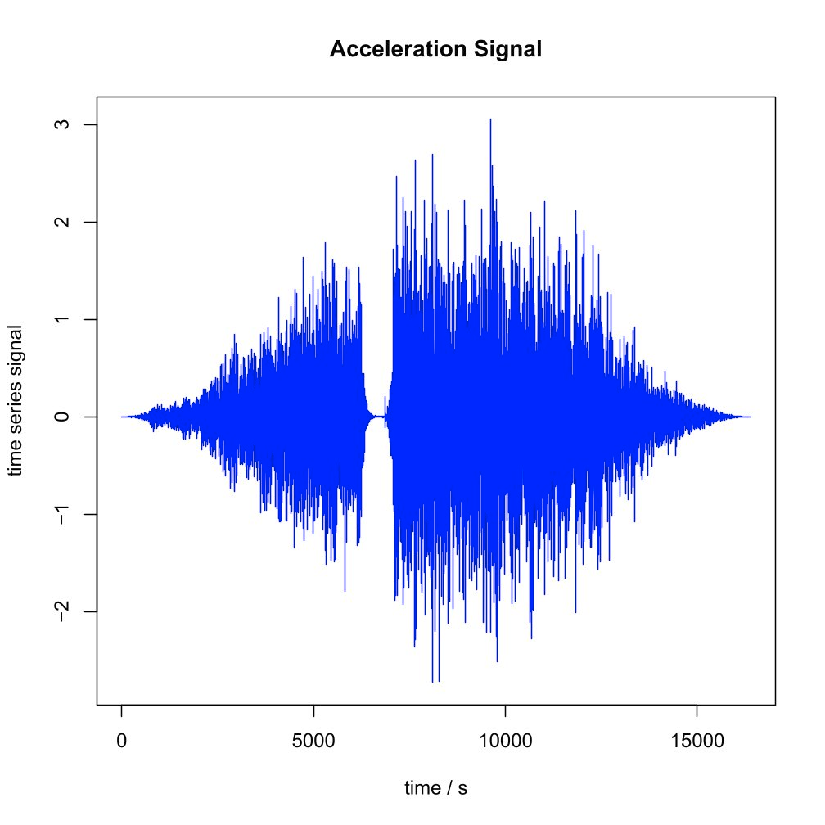
T4.2-Acceleration of Kernels in the HPC System
Hybrid parallel implementation of multiple kernels
Parallelization in shared and distributed memory (OpenMP/MPI)
Task parallelization by distributing task across multiple process
FFT (Fast Fourier Transformation)
FFT Filter
<number>

Slide 5
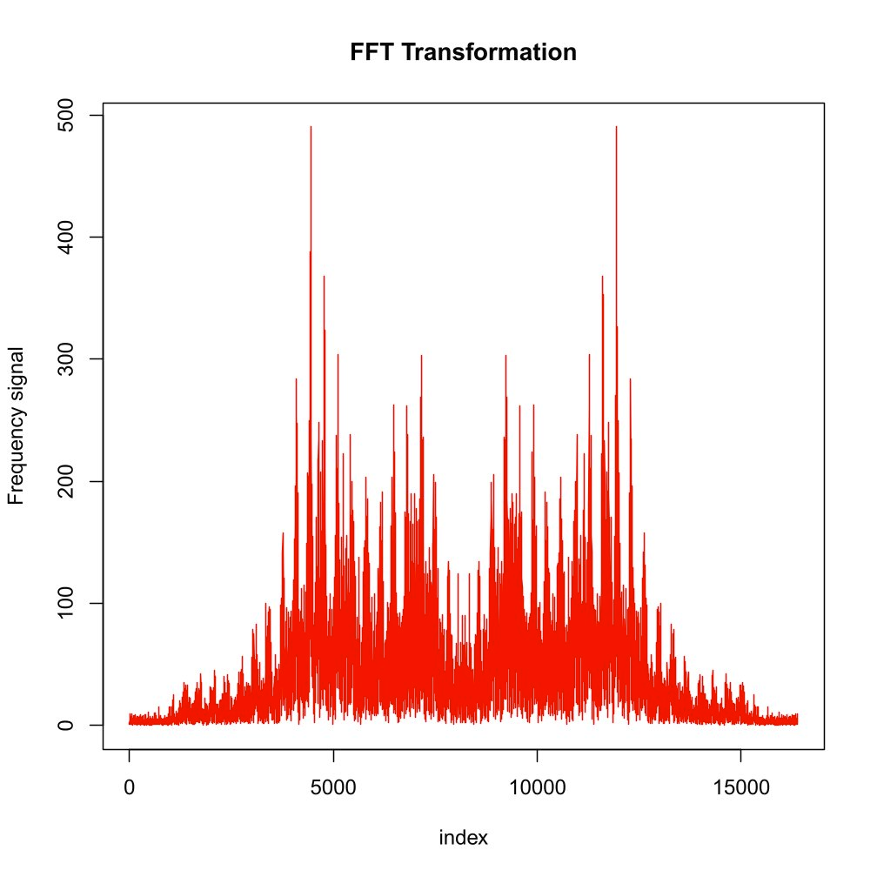
T4.2-Acceleration of Kernels in the HPC System
Hybrid parallel implementation of multiple kernels
Parallelization in shared and distributed memory (OpenMP/MPI)
Task parallelization by distributing task across multiple process
FFT (Fast Fourier Transformation)
FFT Filter
<number>

Slide 6
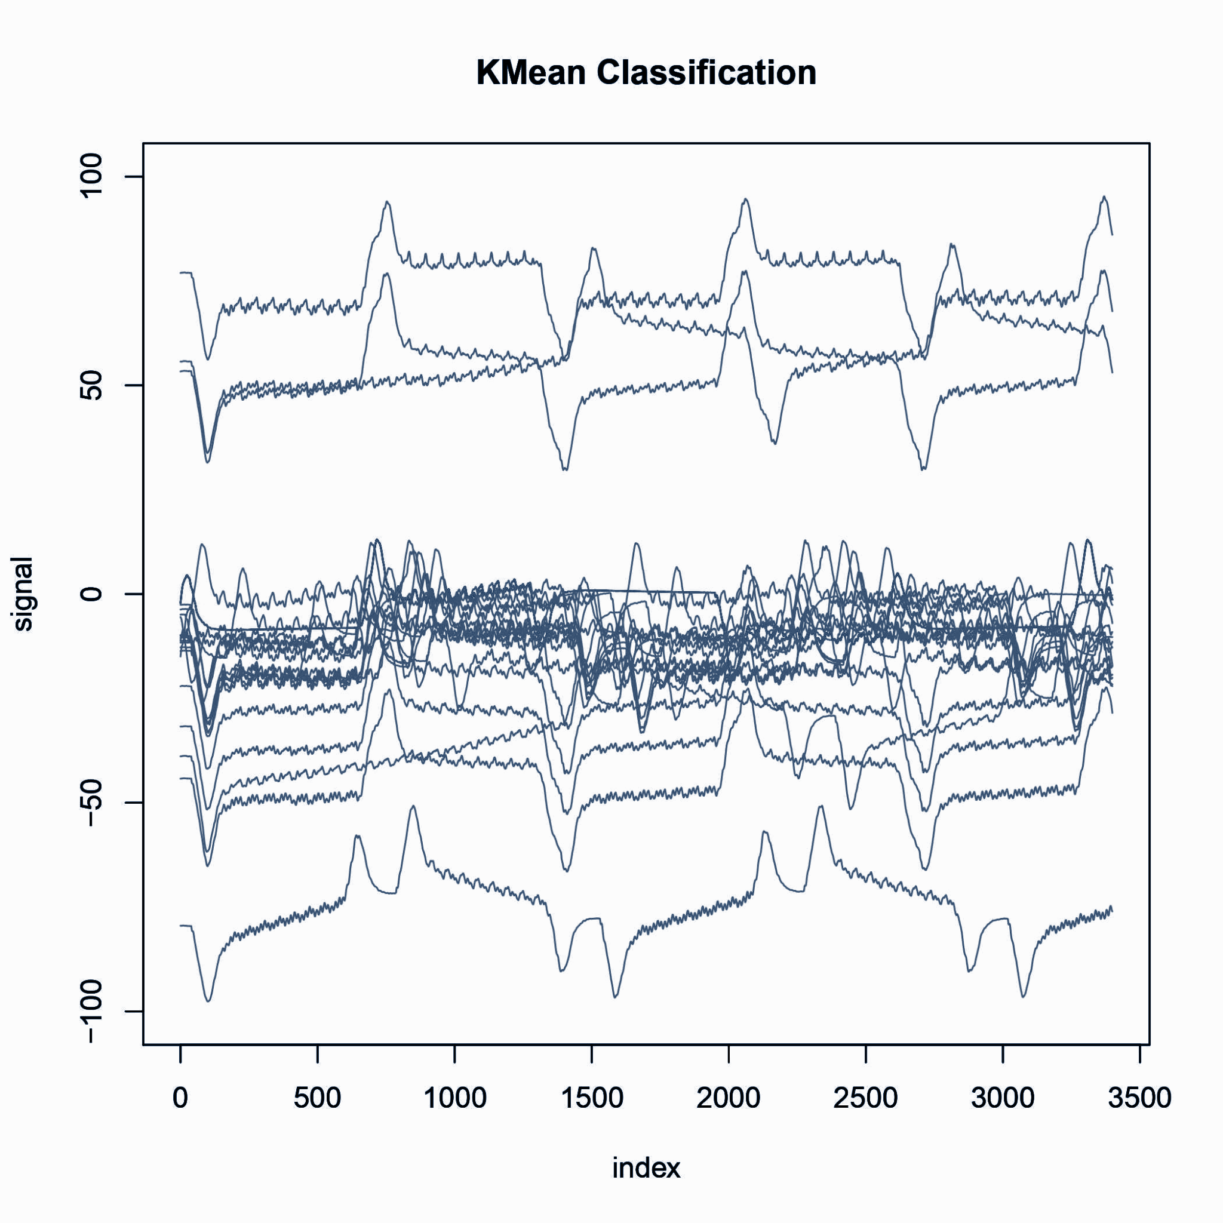
T4.2-Acceleration of Kernels in the HPC System
Hybrid parallel implementation of multiple kernels
Parallelization in shared and distributed memory (OpenMP/MPI)
Task parallelization by distributing task across multiple process
K-Mean Clustering method (with DTW metric)
KMean Classification
<number>

Slide 7
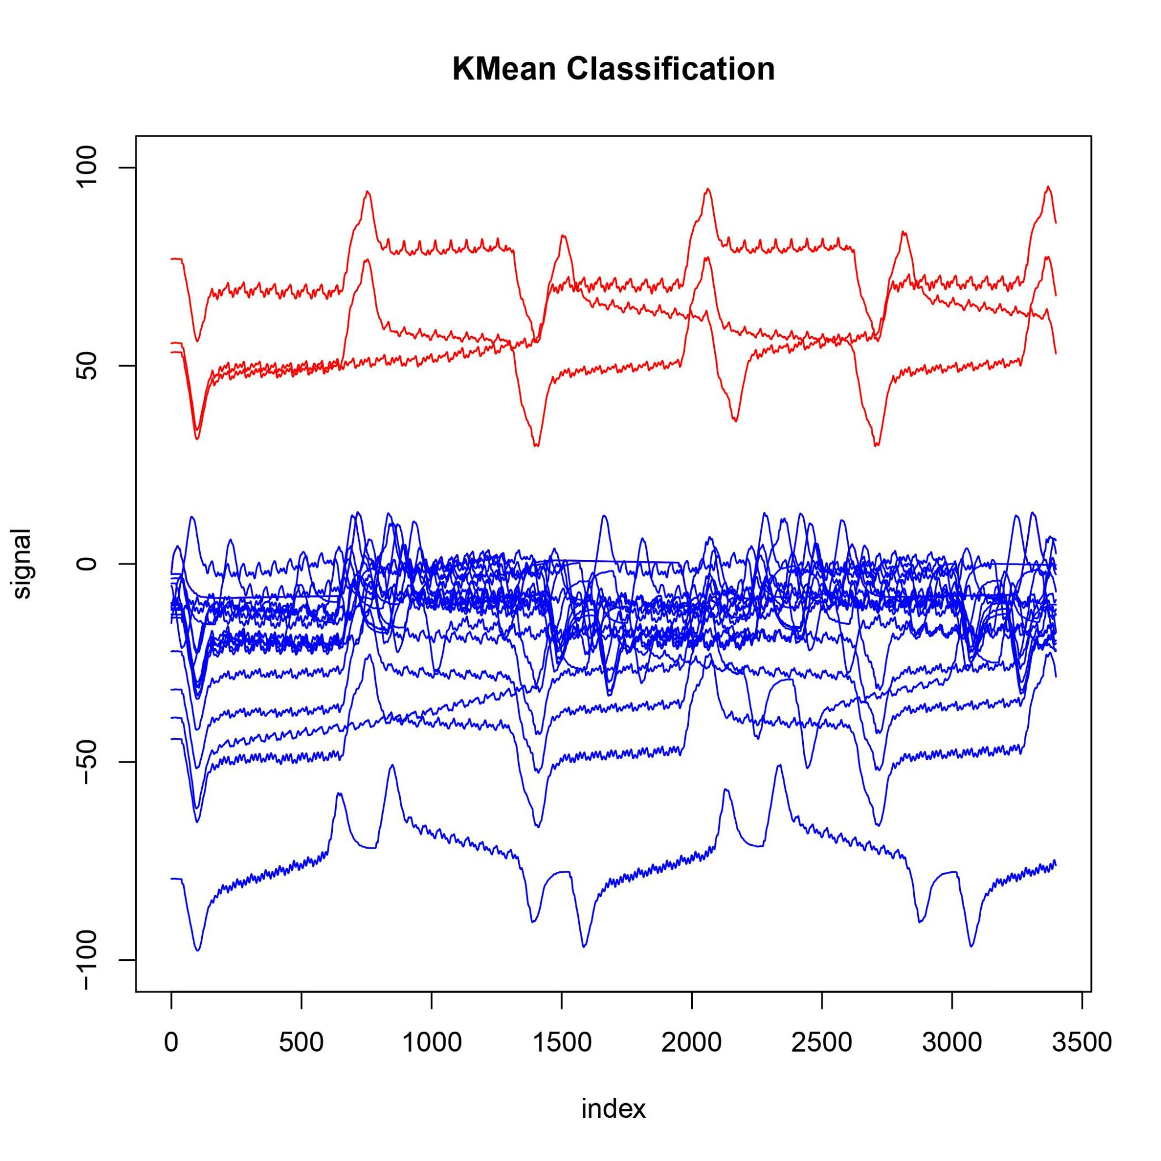
T4.2-Acceleration of Kernels in the HPC System
Hybrid parallel implementation of multiple kernels
Parallelization in shared and distributed memory (OpenMP/MPI)
Task parallelization by distributing task across multiple process
K-Mean Clustering method (with DTW metric)
KMean Classification
<number>

Slide 8
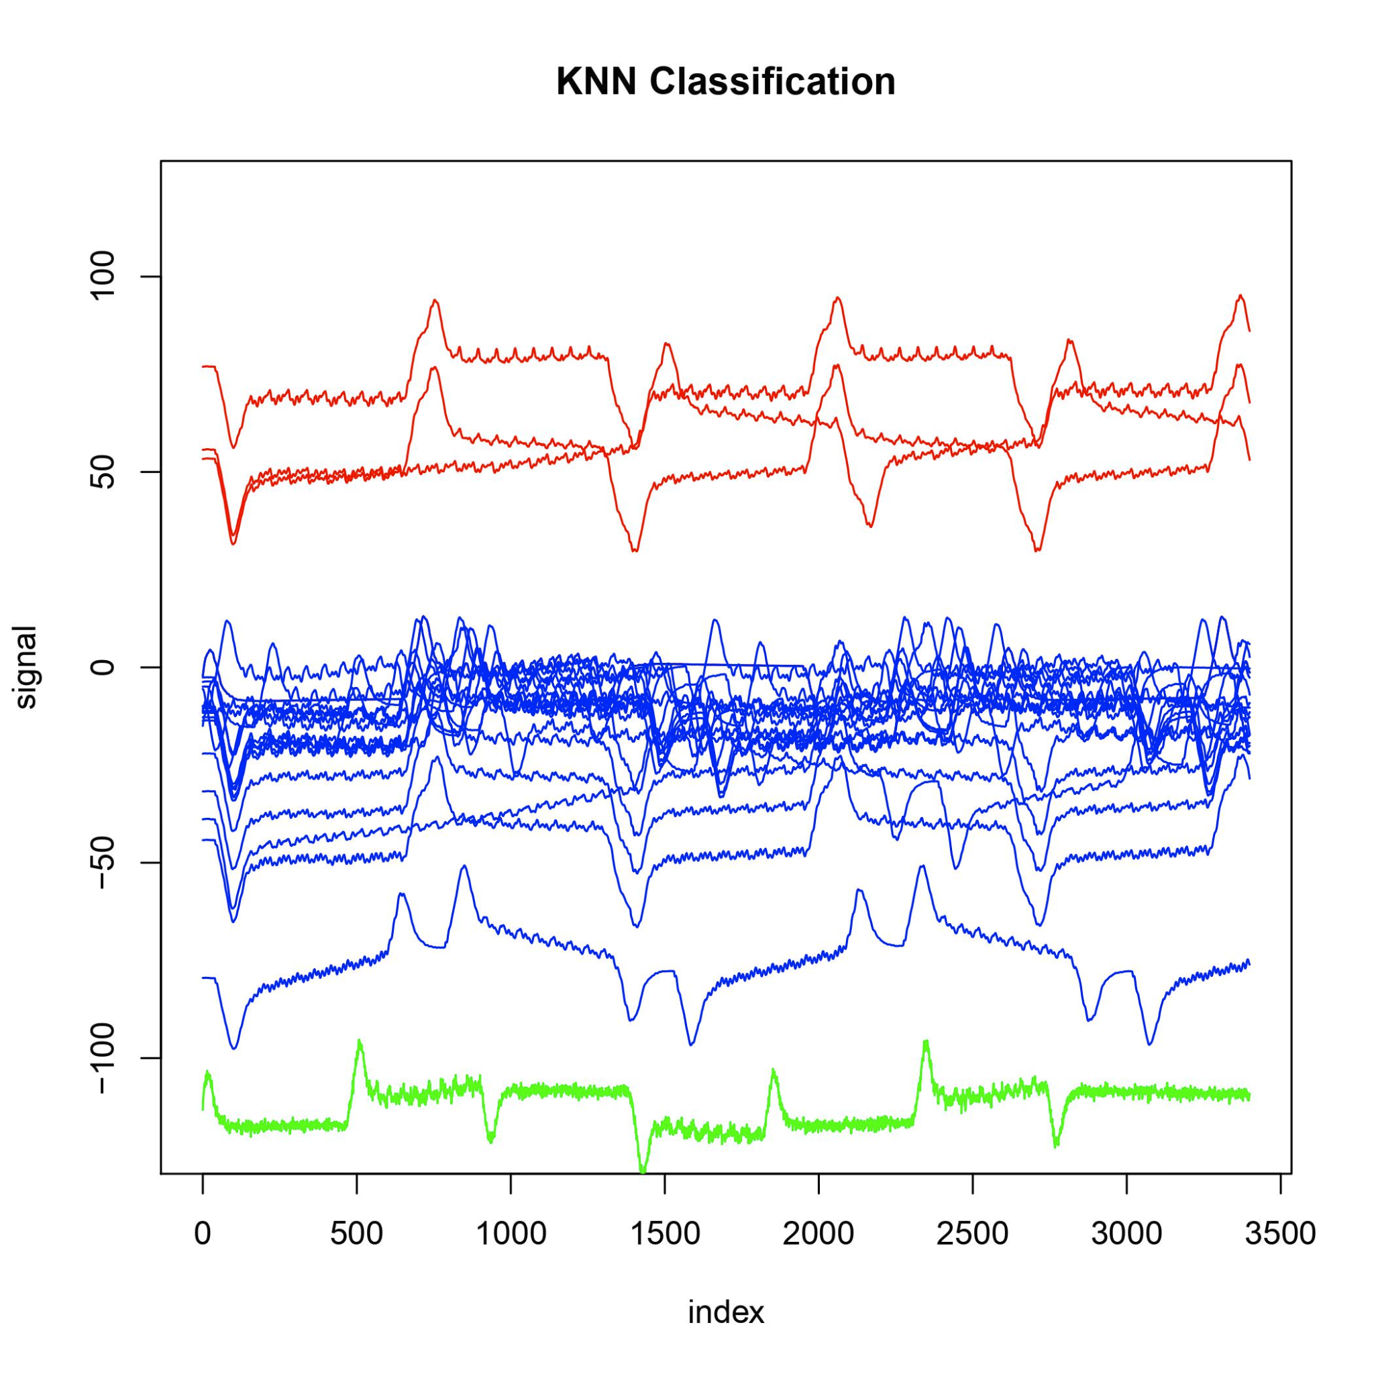
T4.2-Acceleration of Kernels in the HPC System
Hybrid parallel implementation of multiple kernels
Parallelization in shared and distributed memory (OpenMP/MPI)
Task parallelization by distributing task across multiple process
KNN Classification (with DTW metric)
KNN Classification
<number>

Slide 9
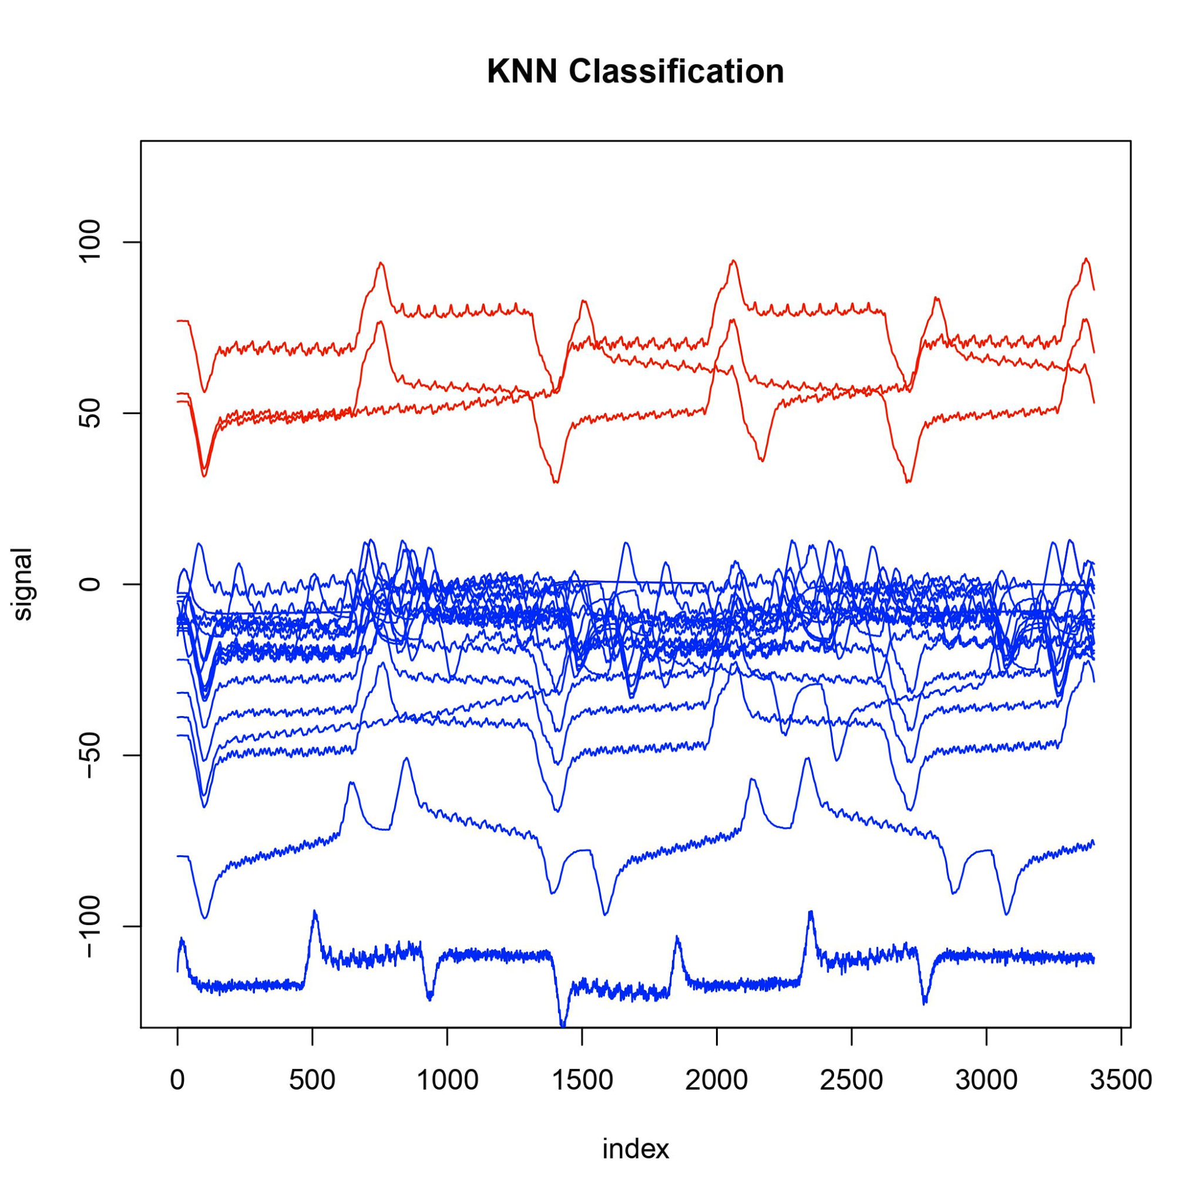
T4.2-Acceleration of Kernels in the HPC System
Hybrid parallel implementation of multiple kernels
Parallelization in shared and distributed memory (OpenMP/MPI)
Task parallelization by distributing task across multiple process
KNN Classification (with DTW metric)
KNN Classification
<number>

Slide 10
T4.2-Acceleration of Kernels in the HPC System
Hybrid parallel implementation of multiple kernels
Parallelization in shared and distributed memory (OpenMP/MPI)
Task parallelization by distributing task across multiple process
FFT Filter
K-Means Clustering method
KNN (K-nearest neighbor) Classification method
Implementing different tools for integration of kernels in HPC-System
<number>

Slide 11
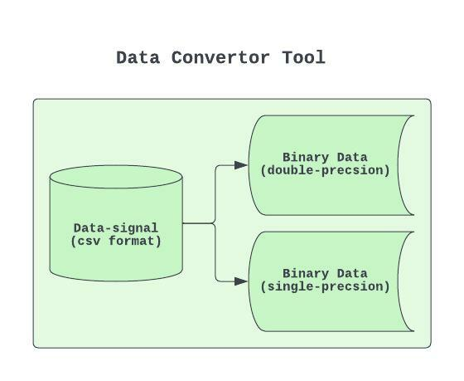
T4.2-Acceleration of Kernels in the HPC System
Hybrid parallel implementation of multiple kernels
Parallelization in shared and distributed memory (OpenMP/MPI)
Task parallelization by distributing task across multiple process
FFT Filter
K-Means Clustering method
KNN (K-nearest neighbor) Classification method
Implementing different tools for integration of kernels in HPC-System
Data convertor tool
Convert data (signals) from CSV format to binary format in different data precision
<number>

Slide 12
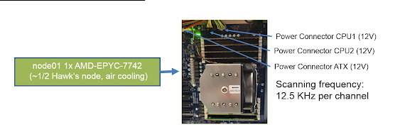
T4.2-Acceleration of Kernels in the HPC System
Hybrid parallel implementation of multiple kernels
Parallelization in shared and distributed memory (OpenMP/MPI)
Task parallelization by distributing task across multiple process
FFT filter
K-Means Clustering method
KNN (K-nearest neighbor) Classification method
Implementing different tools for integration of kernels in HPC-System
Data convertor tool
Convert data (signals) from CSV format to binary format in different data precision
Energy measurement tool
Measuring the energy consumption of Hawk compute node
<number>

Slide 13
T4.2-Acceleration of Kernels in the HPC System
Hybrid parallel implementation of multiple kernels
Parallelization in shared and distributed memory (OpenMP/MPI)
Task parallelization by distributing task across multiple process
FFT filter
K-Means Clustering method
KNN (K-nearest neighbor) Classification method
Implementing different tools for integration of kernels in HPC-System
Data convertor tool
Convert data (signals) from CSV format to binary format in different data precision
Energy measurement tool
Measuring the energy consumption of Hawk compute node
Development of Verification, Validation and Uncertainty Quantification.
Select parallel parameters to minimize the energy consumption and execution runtime
Trade-off between the execution runtime/energy consumption and application accuracy
<number>

Slide 14
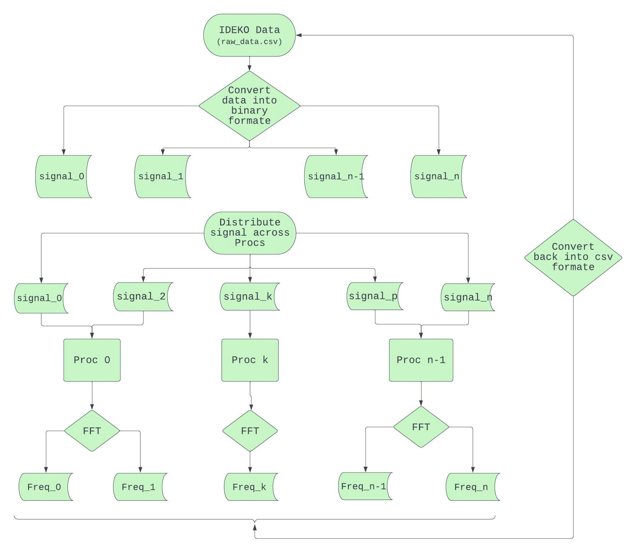

T4.2-Acceleration of IDEKO Use Cases
<number>

Slide 15
T4.2-Acceleration of IDEKO Use Cases
<number>

Slide 16
T4.2-Acceleration of IDEKO Use Cases
<number>

Slide 17
T4.2-Acceleration of IDEKO Use Cases
<number>

Slide 18
T4.2-Acceleration of IDEKO Use Cases
<number>

Slide 19
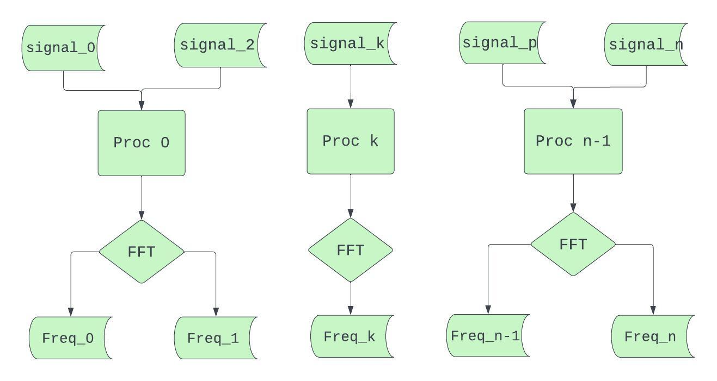
T4.2-Acceleration of FFT Kernel
Acceleration FFT (for acceleration data) in HPC systems
Data | Speedup | Energy | Accuracy %
104 cycle signal | 90X | 33X | 100%
<number>

Slide 20
T4.2-Acceleration of FFT Kernel
Acceleration FFT (for acceleration data) in HPC systems
Applying the transprecision computing techniques
Data | Speedup | Energy | Accuracy %
104 cycle signal | 90X | 33X | 100%
Data | Speedup | Energy | Accuracy % | Input data precision | output data precision
104 cycle signal | 100X | 35X | 100% | single precision | double precision
<number>

Slide 21
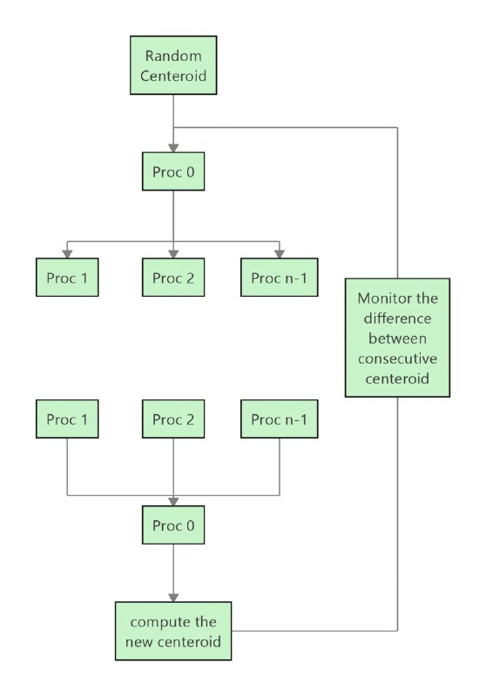
T4.2-Acceleration of KMean Kernel
Acceleration KMean (for position data) in HPC systems
Data | Speedup | Energy | Accuracy % | loop Iteration
110 cycle signal | 59X | 44X | 95% - 100% | 10
<number>

Slide 22
T4.2-Acceleration of KMean Kernel
Acceleration KMean (for position data) in HPC systems
Applying the approximate computing techniques
Data | Speedup | Energy | Accuracy % | loop Iteration
110 cycle signal | 59X | 44X | 95% - 100% | 10
Data | Speedup | Energy | Accuracy % | loop Iteration | centroid accuracy
110 cycle signal | 62X | 46X | 95% - 100% | 3 | 1e-05
<number>

Slide 23
T4.2-Acceleration of KMean Kernel
Acceleration KMean (for position data) in HPC systems
Applying the approximate computing techniques
Applying the transprecision computing techniques
Data | Speedup | Energy | Accuracy % | loop Iteration
110 cycle signal | 59X | 44X | 95% - 100% | 10
Data | Speedup | Energy | Accuracy % | loop Iteration | centroid accuracy
110 cycle signal | 62X | 46X | 95% - 100% | 3 | 1e-05
Data | Speedup | Energy | Accuracy % | loop Iteration | Input/Output data precision
110 cycle signal | 71X | 48X | 95% - 100% | 3 | single precision (float)
<number>

Slide 24
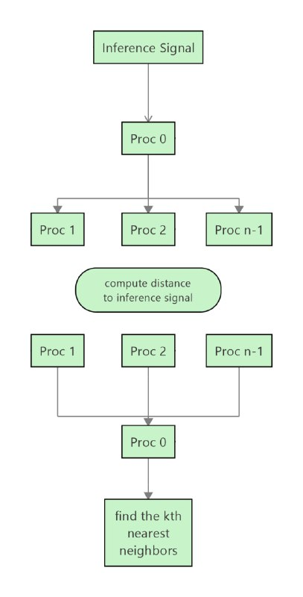
T4.2-Acceleration of KNN Kernel
Acceleration KNN (for position data) in HPC systems
Data | Speedup | Energy | Accuracy %
110 cycle signal | 52X | 38X | 100%
<number>

Slide 25
T4.2-Acceleration of KNN Kernel
Acceleration KNN (for position data) in HPC systems
Applying the transprecision computing techniques
Data | Speedup | Energy | Accuracy %
110 cycle signal | 52X | 38X | 100%
Data | Speedup | Energy | Accuracy % | Input/Output data precision
110 cycle signal | 53X | 40X | 100% | single precision (float)
<number>

Slide 26
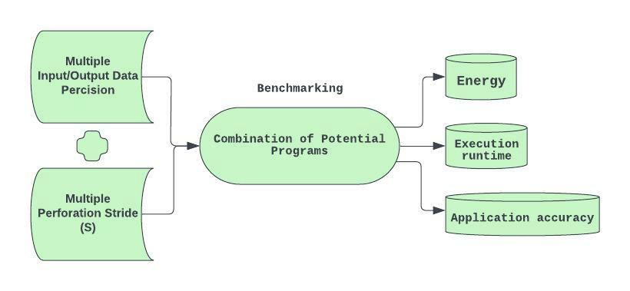
T4.2-Transprecision and Approximate Computing Techniques
Automated Benchmarking with regard to Approximation and Transprecision computing techniques.
<number>

Slide 27
T4.2-Transprecision and Approximate Computing Techniques
Automated Benchmarking with regard to Approximation and Transprecision computing techniques.
<number>

Slide 28

T4.2-Transprecision and Approximate Computing Techniques
Automated Benchmarking with regard to Approximation and Transprecision computing techniques.
<number>

Slide 29

T4.2-Integration of the HPC Service toward VVUQ
Demo for automated benchmarking of kernels
<number>

Slide 30
T4.2-Development of VVUQ Tool
Development of framework for Verification, Validation and Uncertainty Quantification (VVUQ)
<number>

Slide 31
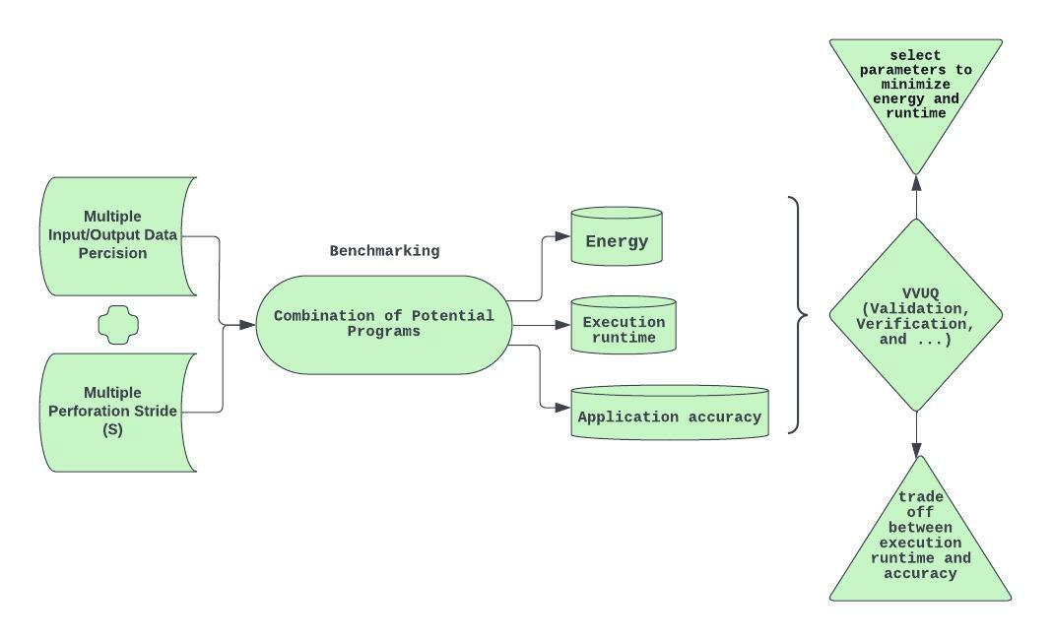
T4.2-Development of VVUQ Tool
Development of framework for Verification, Validation and Uncertainty Quantification (VVUQ)
<number>

Slide 32
T4.2-Development of VVUQ Tool
Development of framework for Verification, Validation and Uncertainty Quantification (VVUQ)
Select parallel parameter to minimizes the execution runtime and energy consumption
7th-plenary meeting
<number>

Slide 33
T4.2-Development of VVUQ Tool
Development of framework for Verification, Validation and Uncertainty Quantification (VVUQ)
Select parallel parameter to minimizes the execution runtime and energy consumption
Analyzes trade off between the execution runtime and application accuracy
<number>

Slide 34
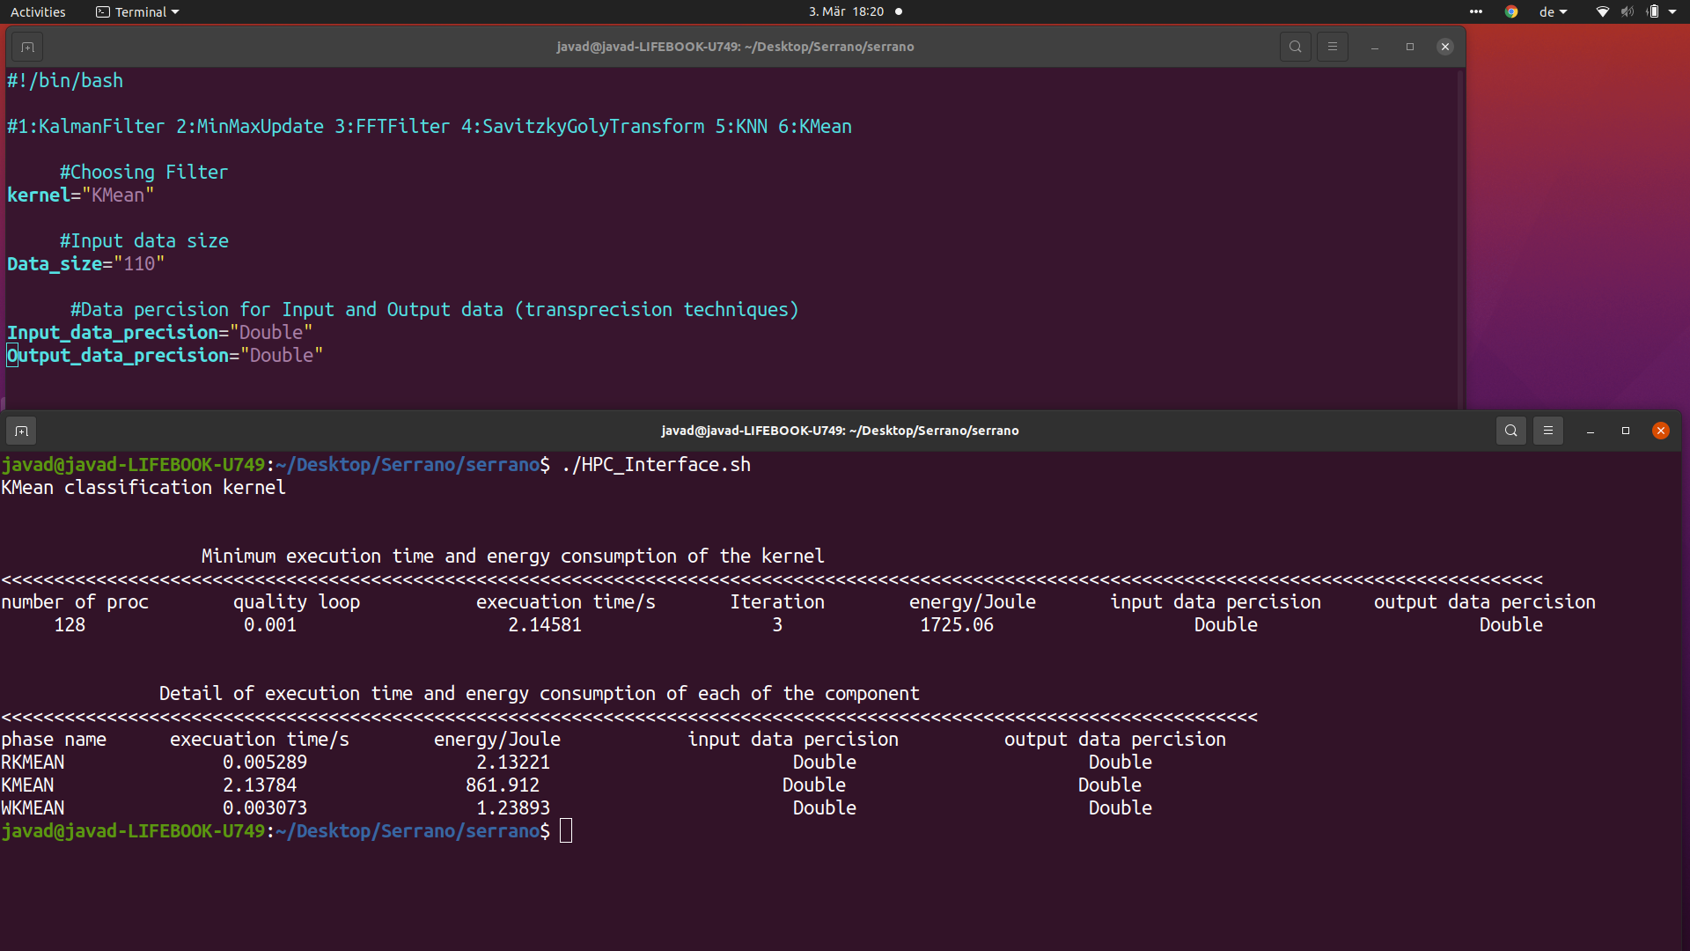
T4.2-Development of VVUQ Tool
Development of framework for Verification, Validation and Uncertainty Quantification (VVUQ)
<number>

Slide 35
T4.2-Development of VVUQ Tool
Development of framework for Verification, Validation and Uncertainty Quantification (VVUQ)
Select parallel parameter to minimizes the execution runtime and energy consumption
<number>

Slide 36
T4.2-Next Steps
Acceleration the InBestMe Kernels
Writing the final deliverable of the WP4
Finalized the implementation of Kernels and Benchmarking
<number>

